Slide 1
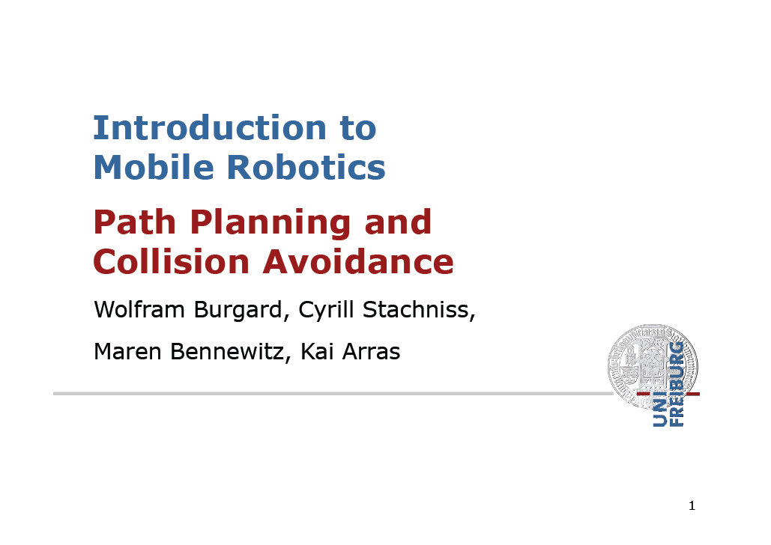

Slide 2
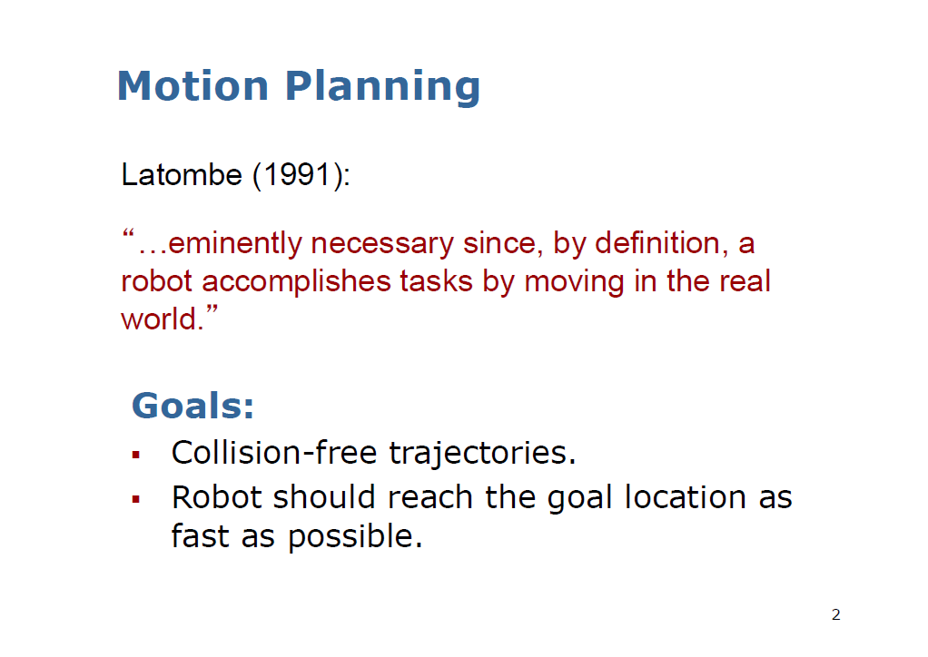

Slide 3
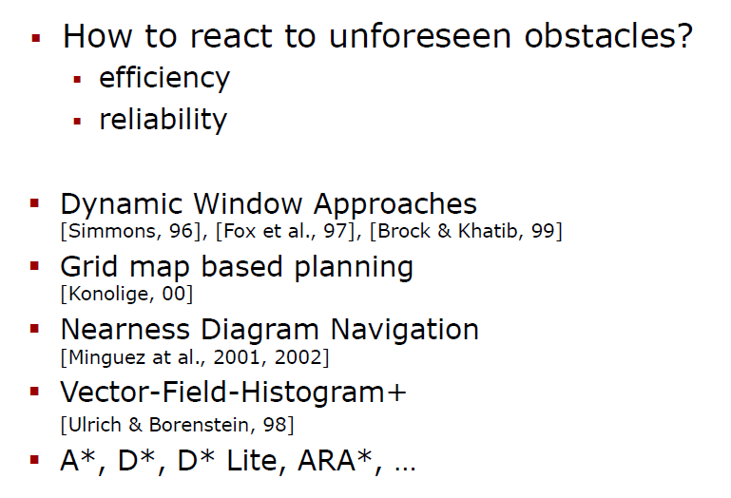
Motion Planning in Dynamic Environments

Slide 4
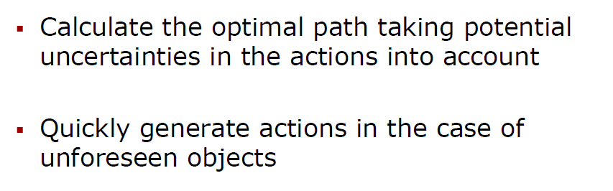
Two Challenges for Optimal Path planning

Slide 5
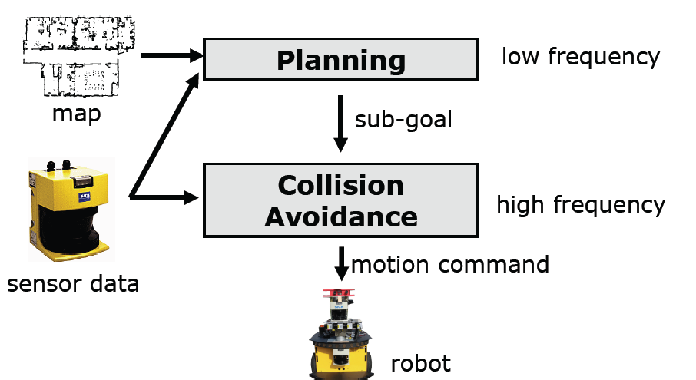
Classic Two-Layered Architecture for Mobile Robots

Slide 6
Dynamic Window Approach (DWA)

Slide 7
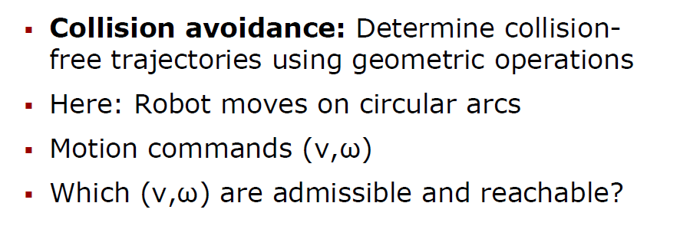
Dynamic Window Approach

Slide 8
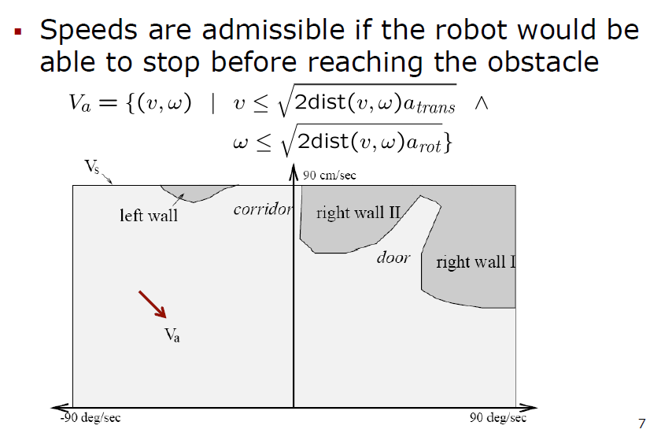
Admissible Velocities

Slide 9
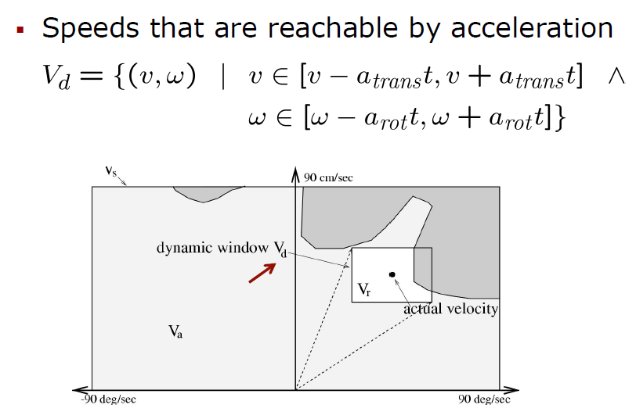
Reachable Velocities

Slide 10
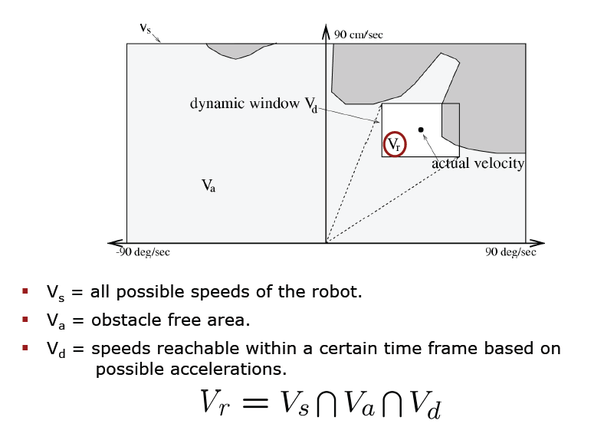
DWA Search Space

Slide 11
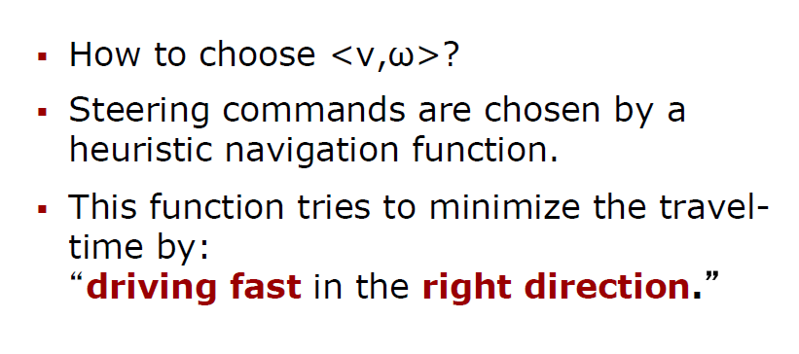
Dynamic Window Approach

Slide 12
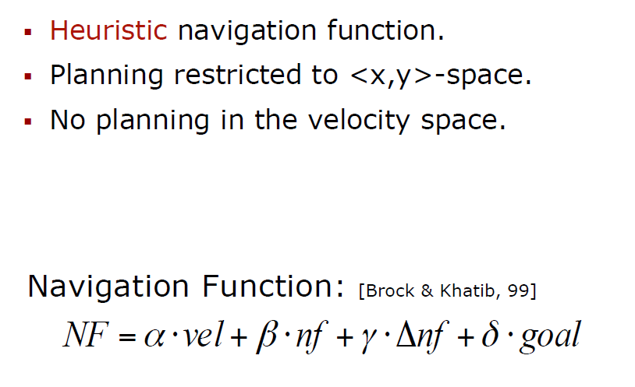
Dynamic Window Approach

Slide 13
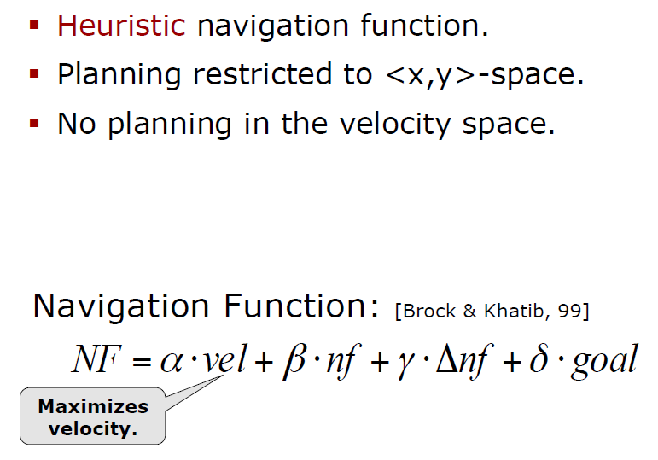
Dynamic Window Approach

Slide 14
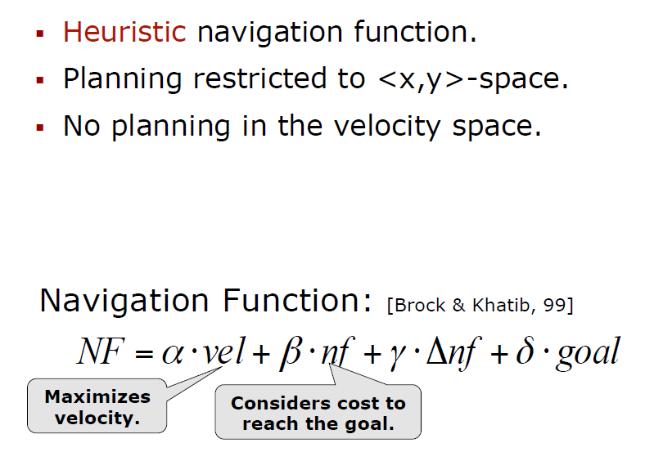
Dynamic Window Approach

Slide 15
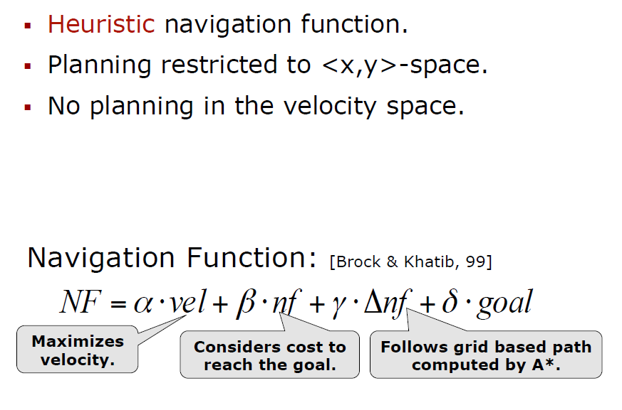
Dynamic Window Approach

Slide 16
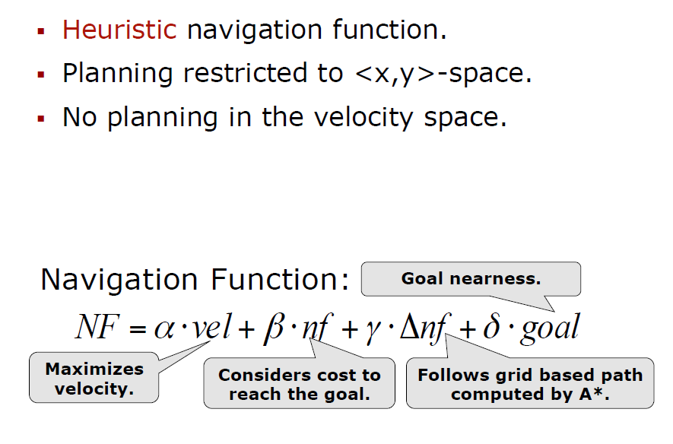
Dynamic Window Approach

Slide 17
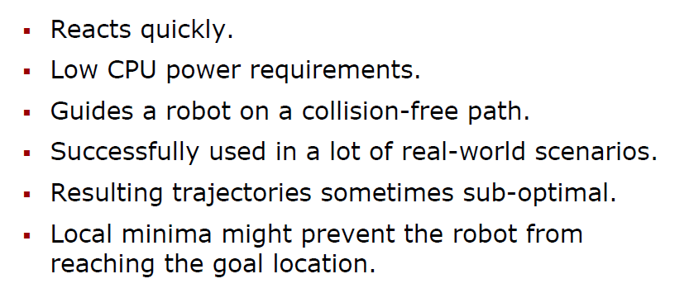
Dynamic Window Approach: PLUSES of this method

Slide 18
Problems of DWA

Slide 19
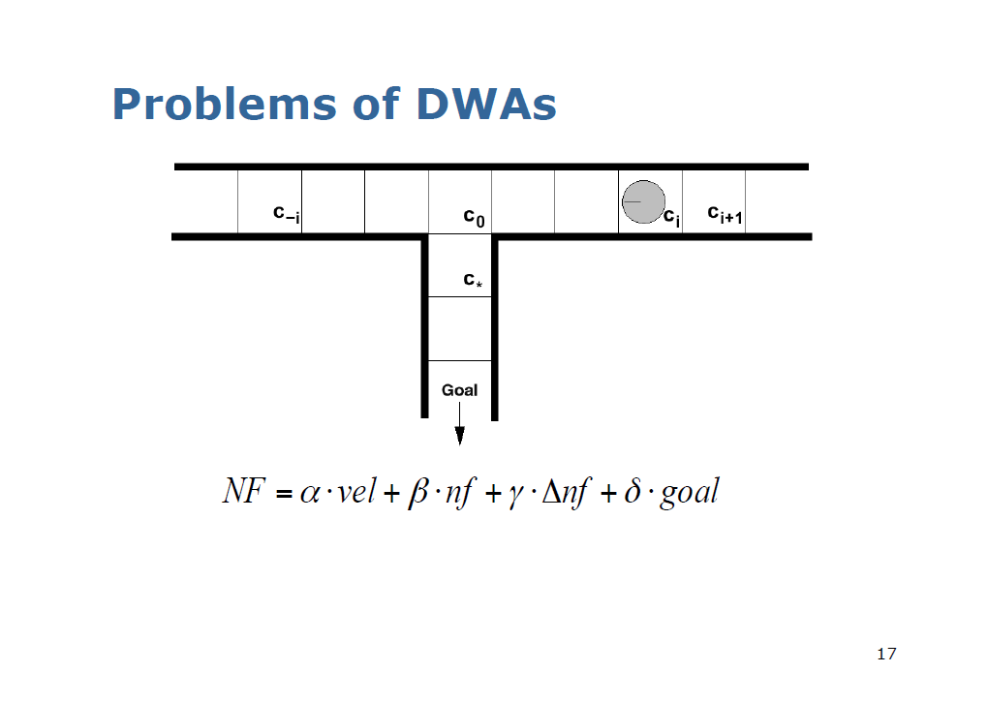

Slide 20
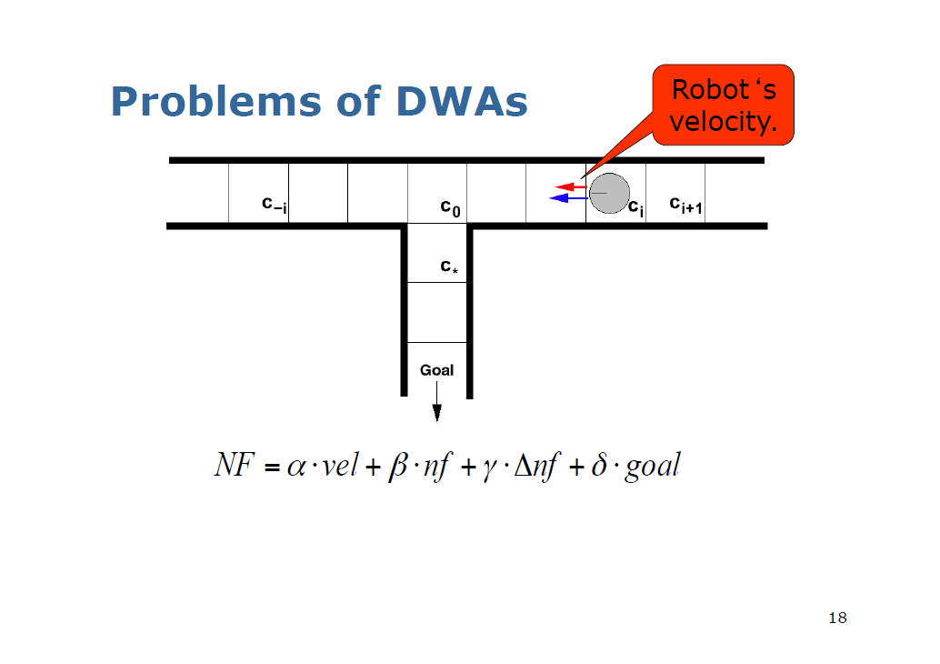

Slide 21
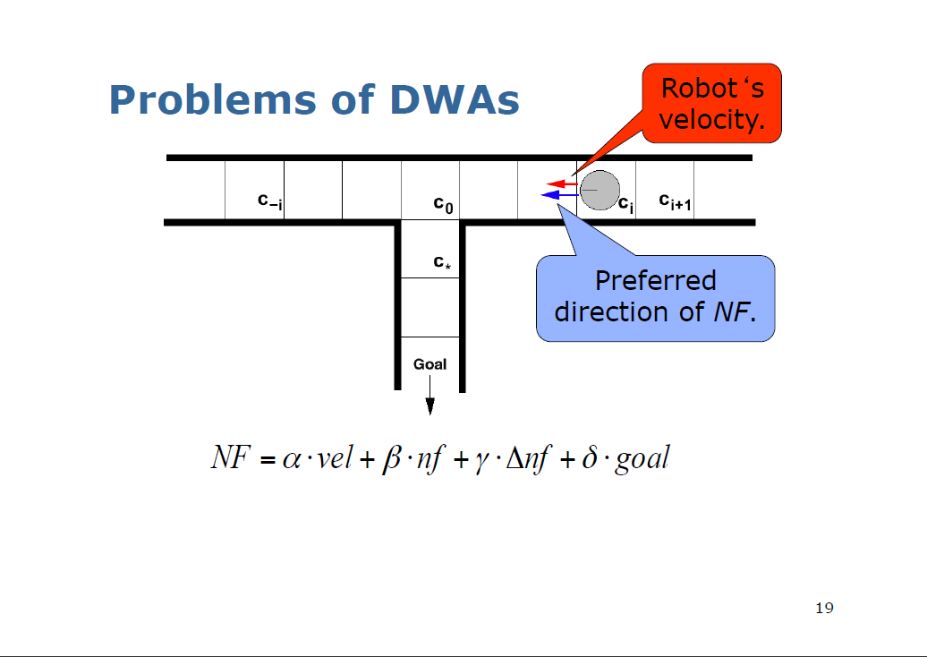

Slide 22


Slide 23
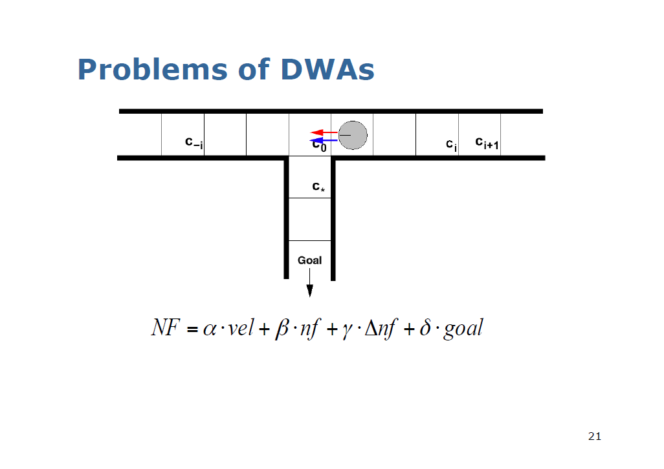

Slide 24
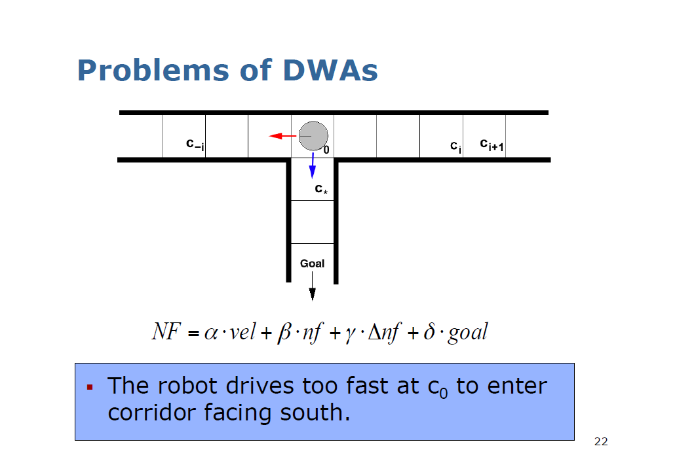

Slide 25
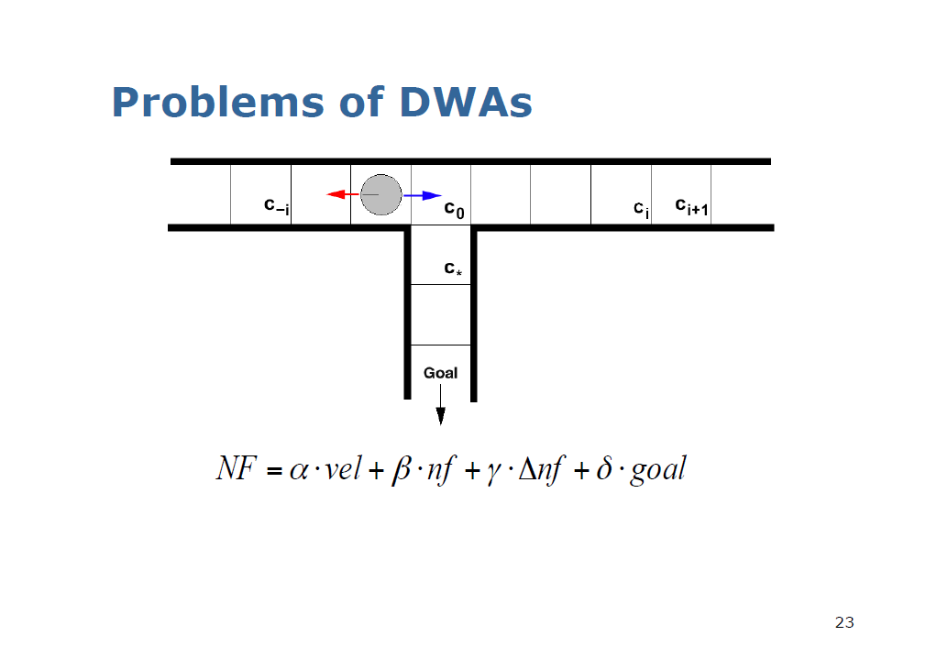

Slide 26


Slide 27
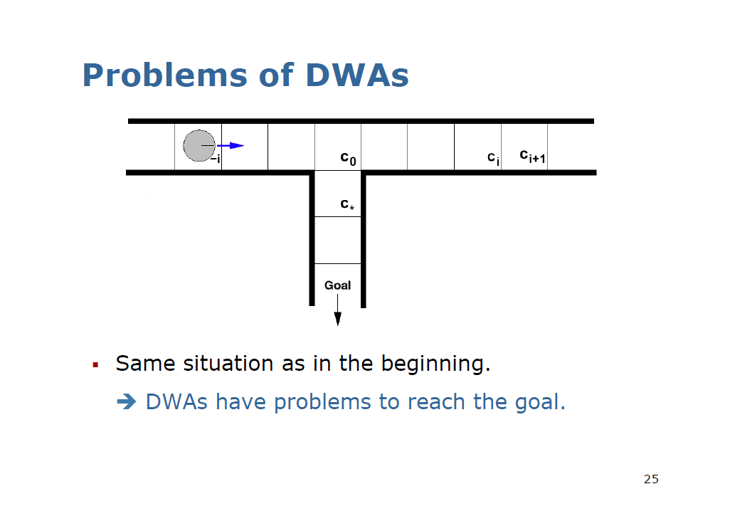

Slide 28
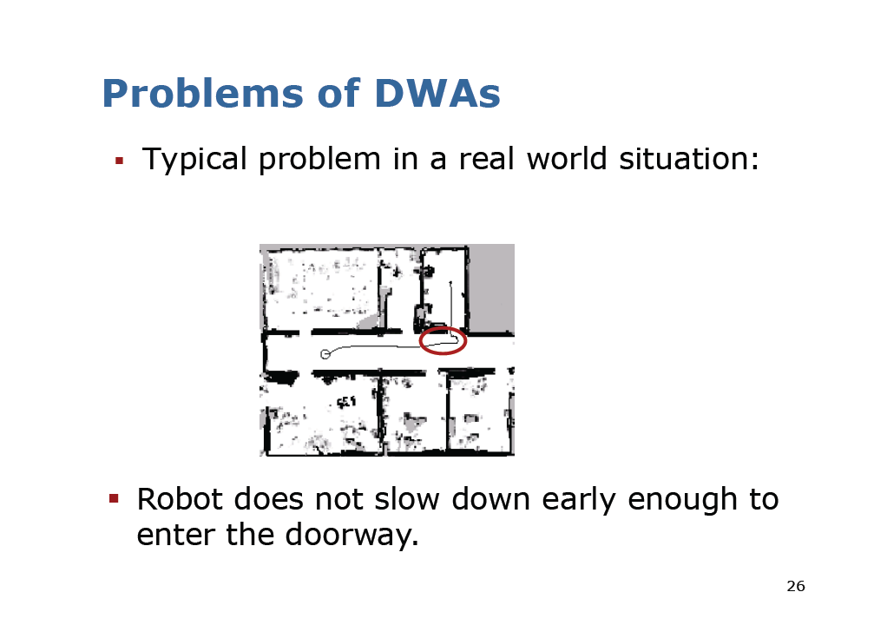

Slide 29
Robot Path Planning with A*

Slide 30
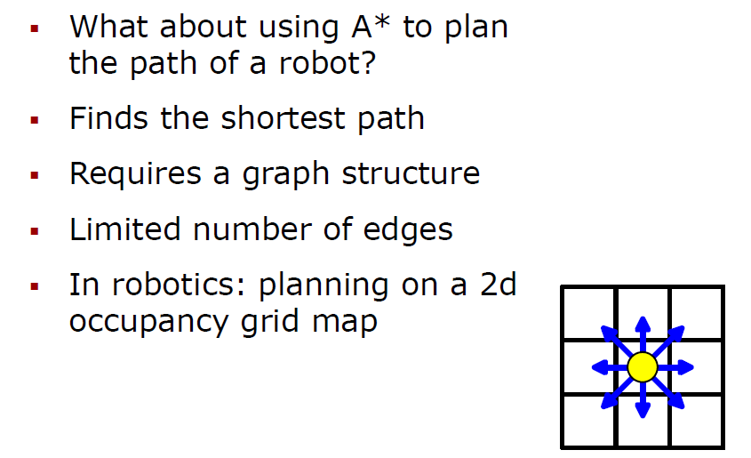
Robot Path Planning with A*

Slide 31
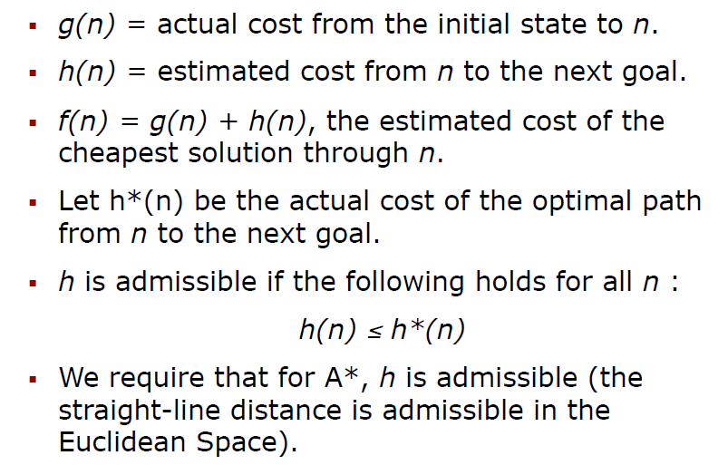
A*: Minimize the estimated Path Costs

Slide 32
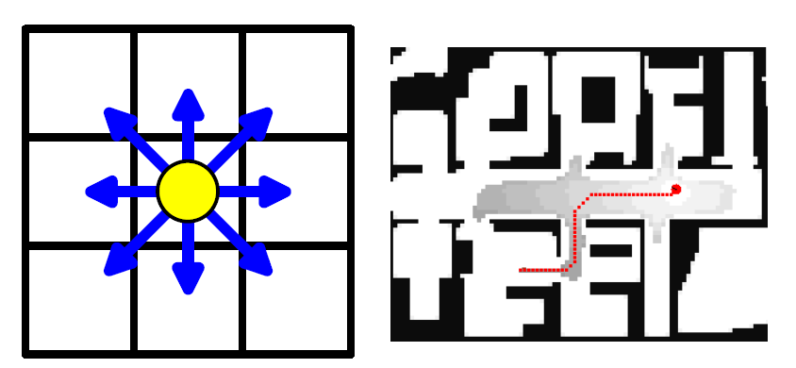
Example: Path Planning for Robots in a Grid-World

Slide 33
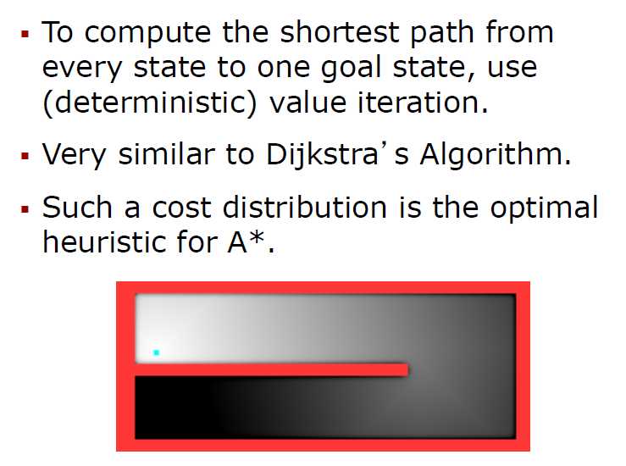
Deterministic Value Iteration

Slide 34
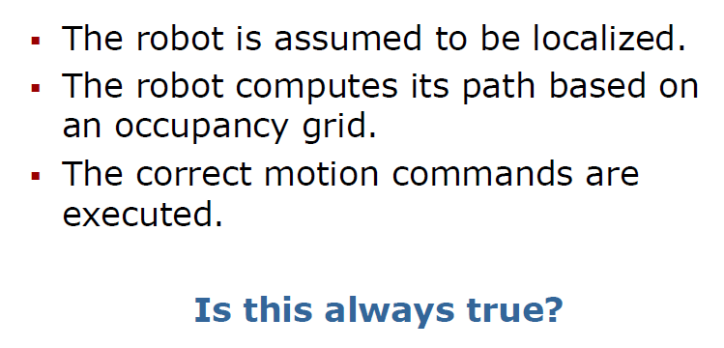
Typical Assumption in Robotics for A* Path Planning

Slide 35
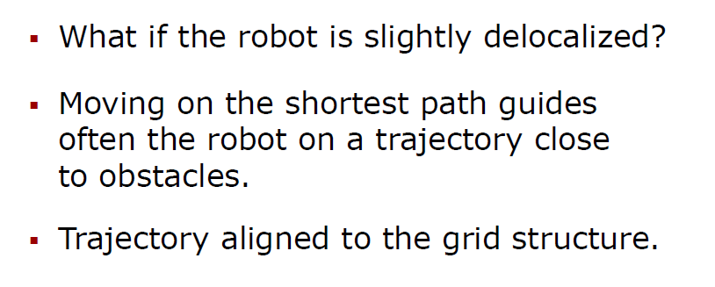
Problems with A* for robot path planning

Slide 36
Convolution of the Grid Map

Slide 37
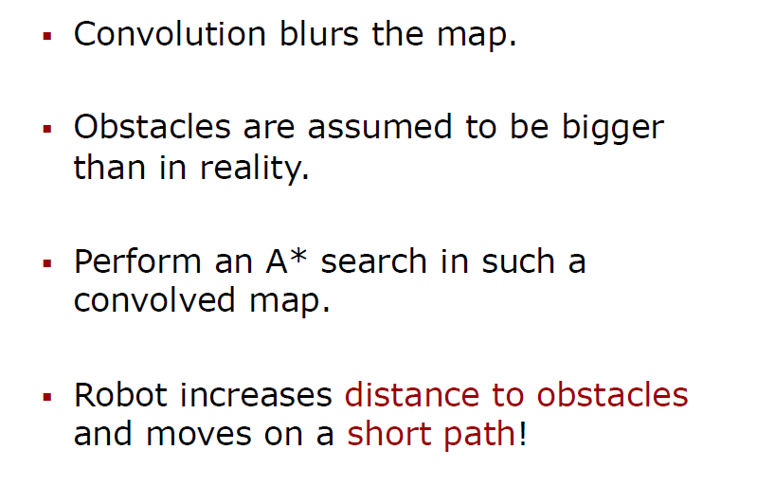
Convolution of the Grid Map

Slide 38
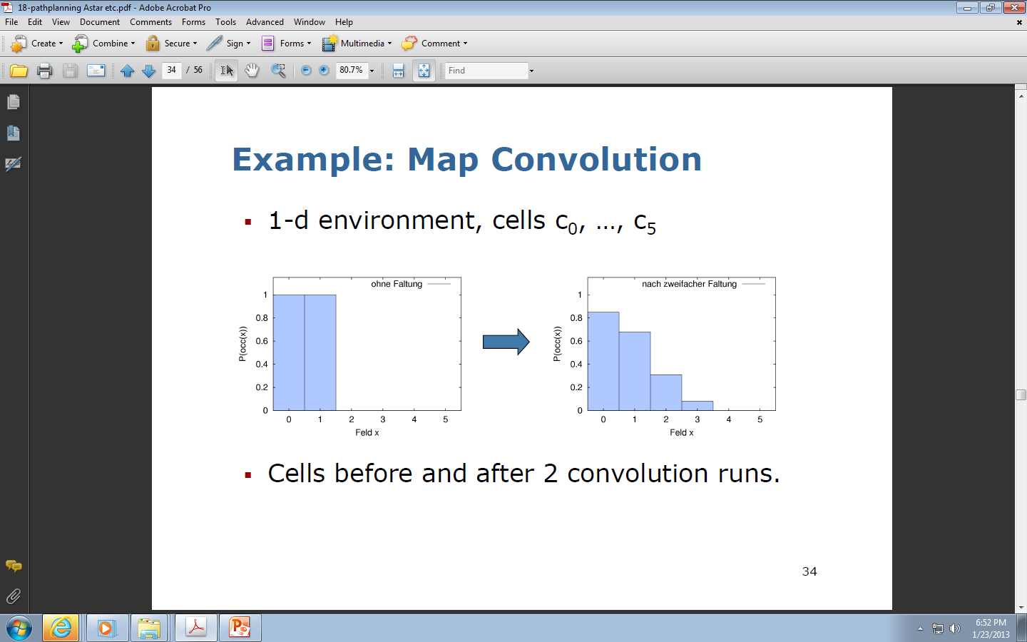
Example: Map Convolution

Slide 41
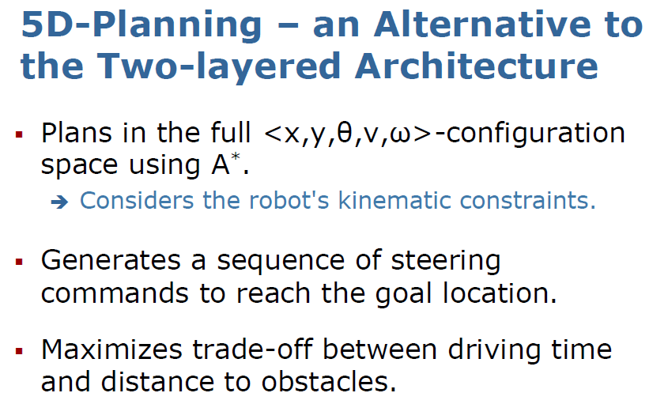
5D – Planning.
An Alternative to Two-Layered Architecture

Slide 42
The Search Space

Slide 43
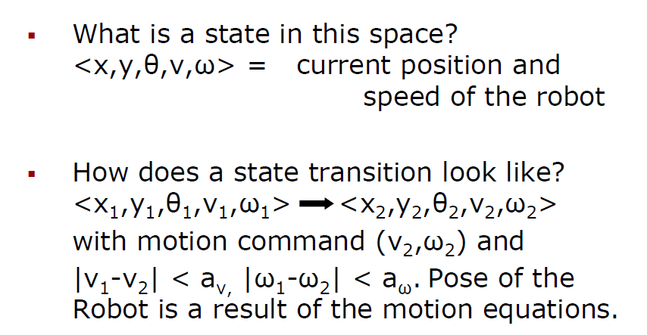
The Search Space Problem formulation

Slide 44
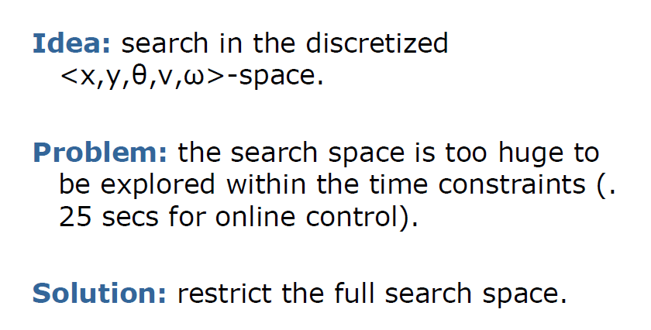
The Search Space Problem Formalization (2)
What is the problem?
What is a solution?

Slide 45
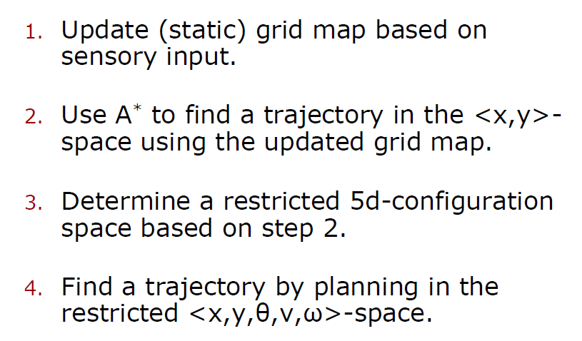
The Main Steps of the 5D algorithm

Slide 46
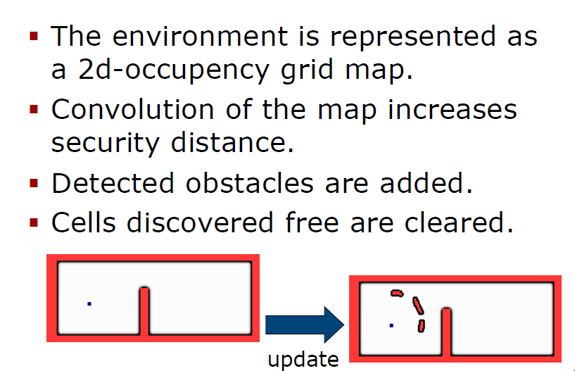
Updating the Grid Map

Slide 47
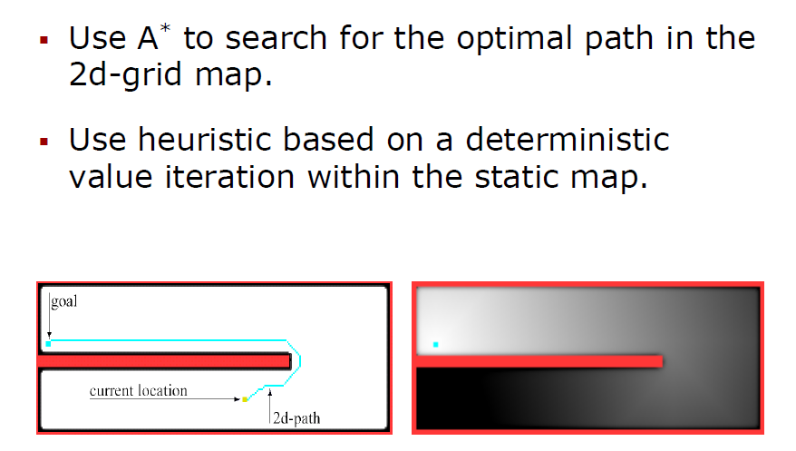
Find a Path in the 2D-Space

Slide 48
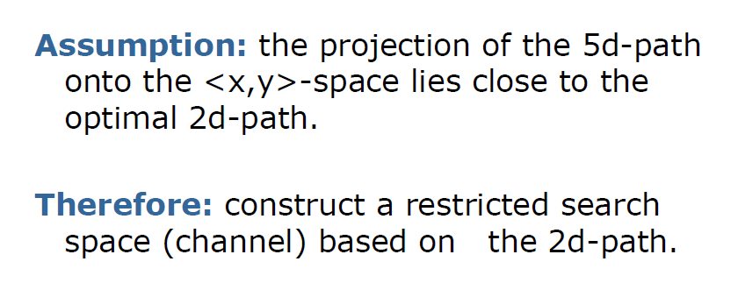
Restricting the Search Space

Slide 49
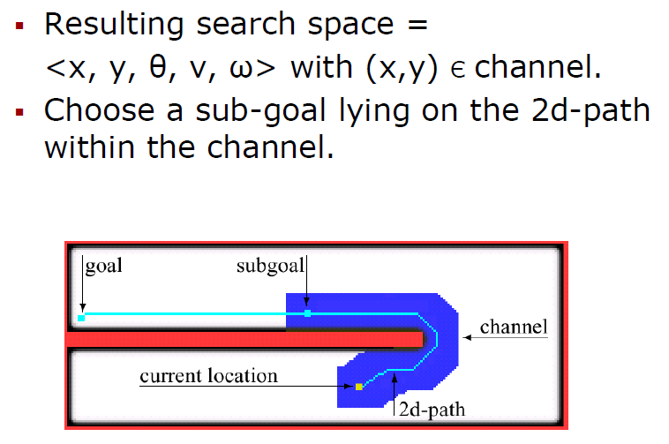
Space Restriction

Slide 50
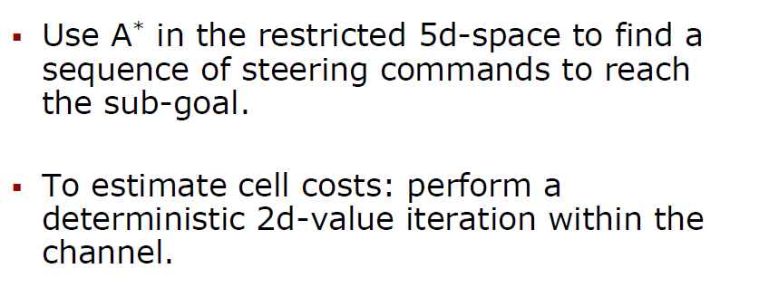
Find a Path in the Five Dimensional Space

Slide 51
Example and Comparisons to other approaches

Slide 52
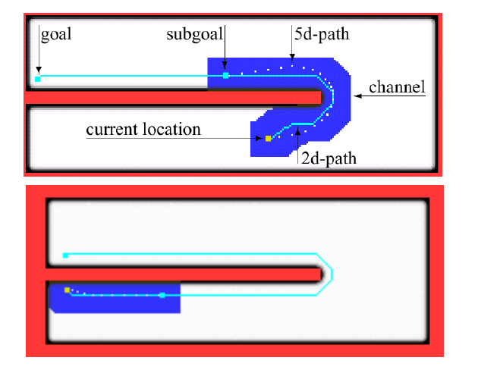
Example

Slide 53
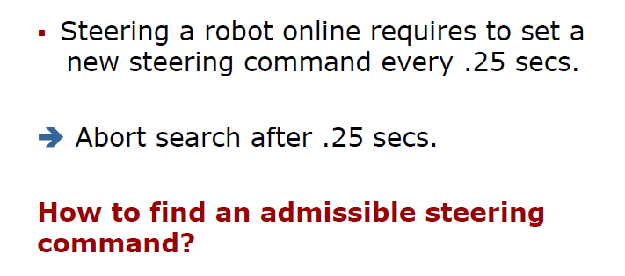
Timeouts

Slide 54
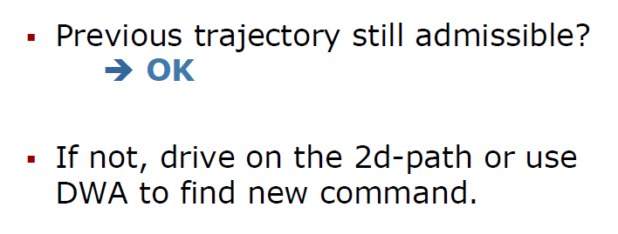
Alternative Steering Command

Slide 55
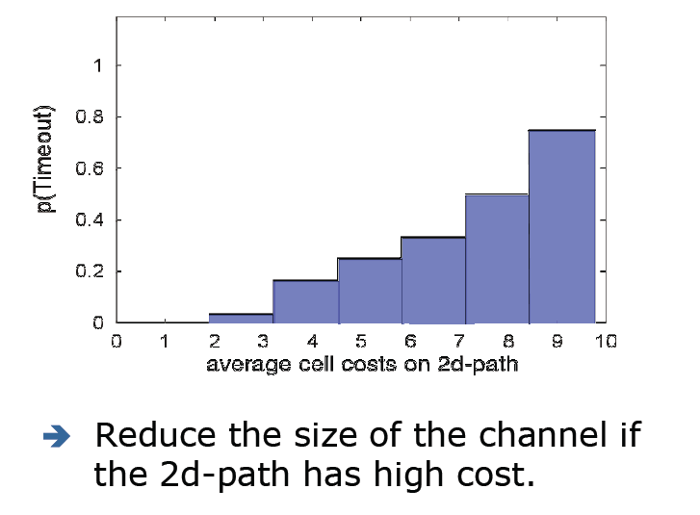
Timeout Avoidance

Slide 56
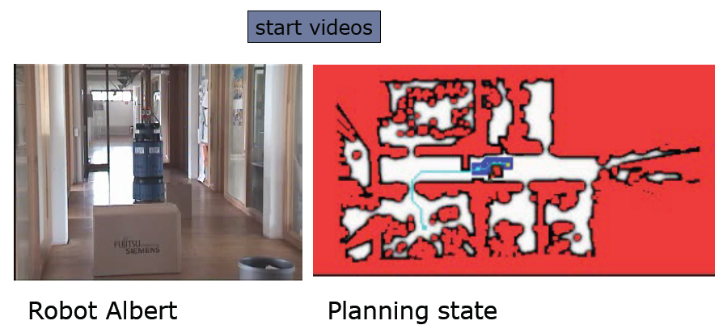
Another Example and Comparisons

Slide 57
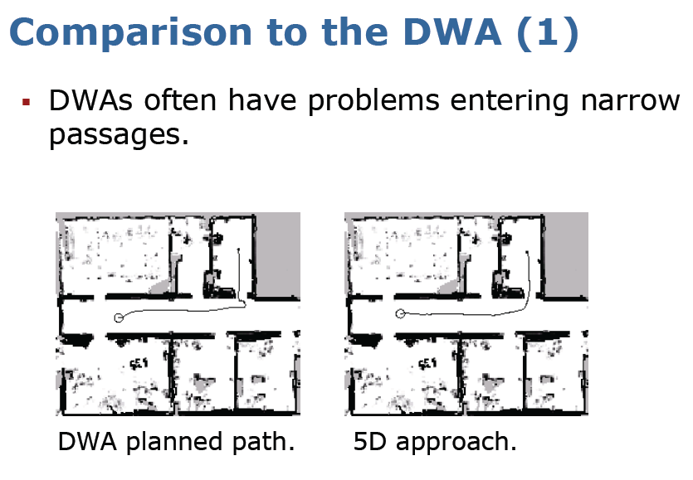

Slide 58


Slide 59
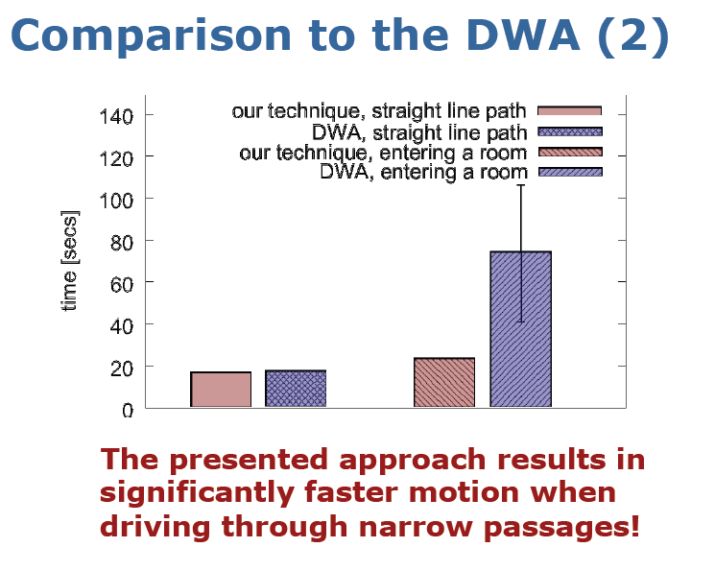

Slide 60
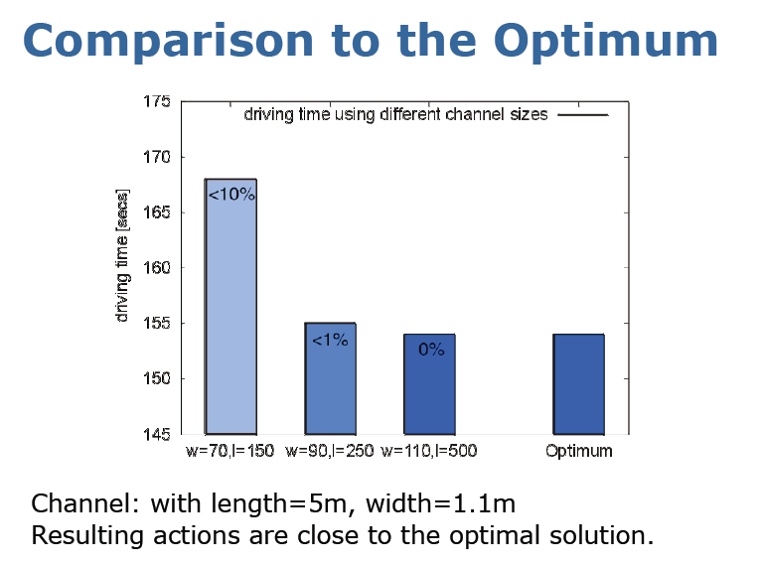

Slide 61
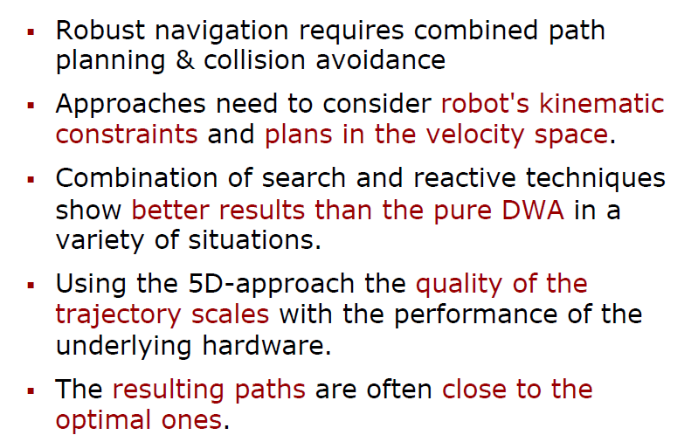
Summary

Slide 62

What else should be discussed?

